Slide 1

Guide to Using JIRA
Manager Role

Slide 2

Overview
  Access to JIRA
  Issues Navigator
  Common Action On An Issue
  JIRA Dashboard and share
  DAMS Viewer
  “Support” Project

Slide 3
Overview
  Access to JIRA
  Issues Navigator
  Common Action On An Issue
  JIRA Dashboard and share
  DAMS Viewer
  “Support” Project

Slide 4
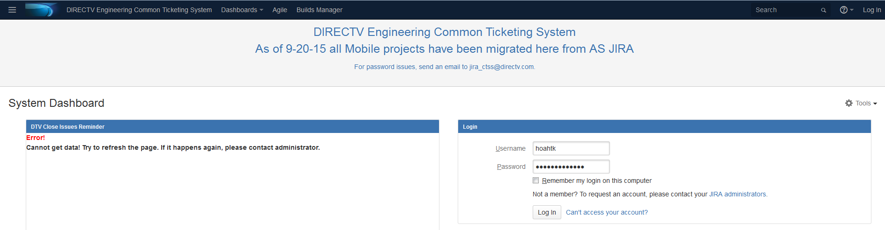

Access To Jira
Use your web browser to access JIRA at:
https://jira.dtvops.net/secure/Dashboard.jspa
If you are a vendor that VPN’s in you will reach the CTS JIRA via https://10.13.116.122/secure/Dashboard.jspa
Login with your username and password to continue

Slide 5
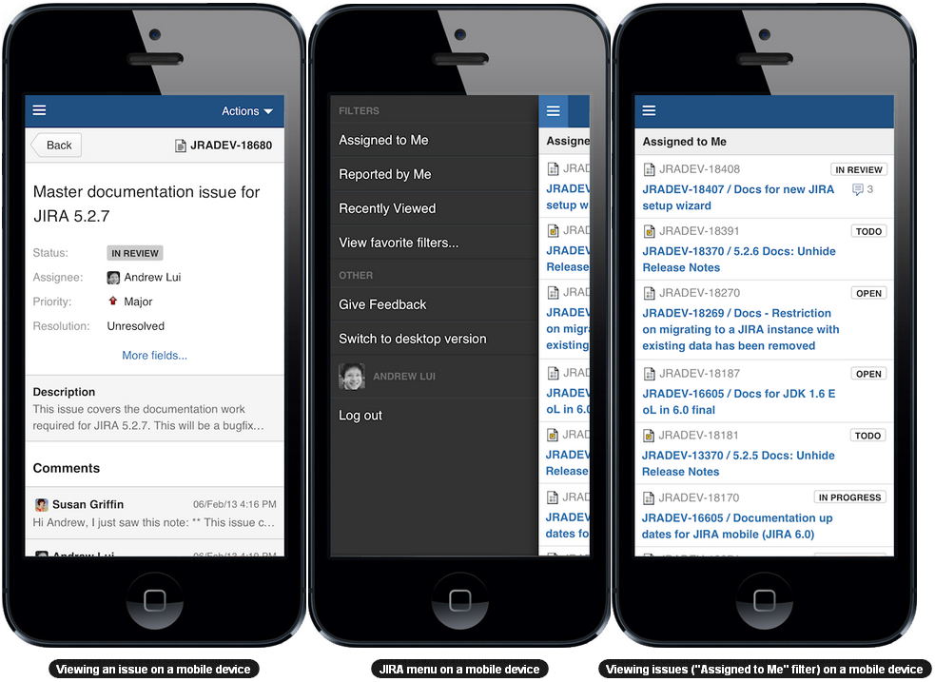
Using JIRA on a Mobile Device
When you view a JIRA page on a mobile device, such as an iPhone or an Android phone, JIRA will display an optimized version of the page. JIRA chooses the mobile or desktop interface based on your device
The JIRA mobile interface is designed for viewing and interacting with issues on the go
If you need full access to JIRA, you can always switch to the JIRA desktop interface via the mobile menu

Slide 6
Overview
  Access to JIRA
  Search and filter issue
  Common Action On An Issue
  JIRA Dashboard and share
  DAMS Viewer
  “Support” Project

Slide 7
Issues Navigator
Quick Search
Basic Search
Advanced Search
Issue Filters

Slide 8
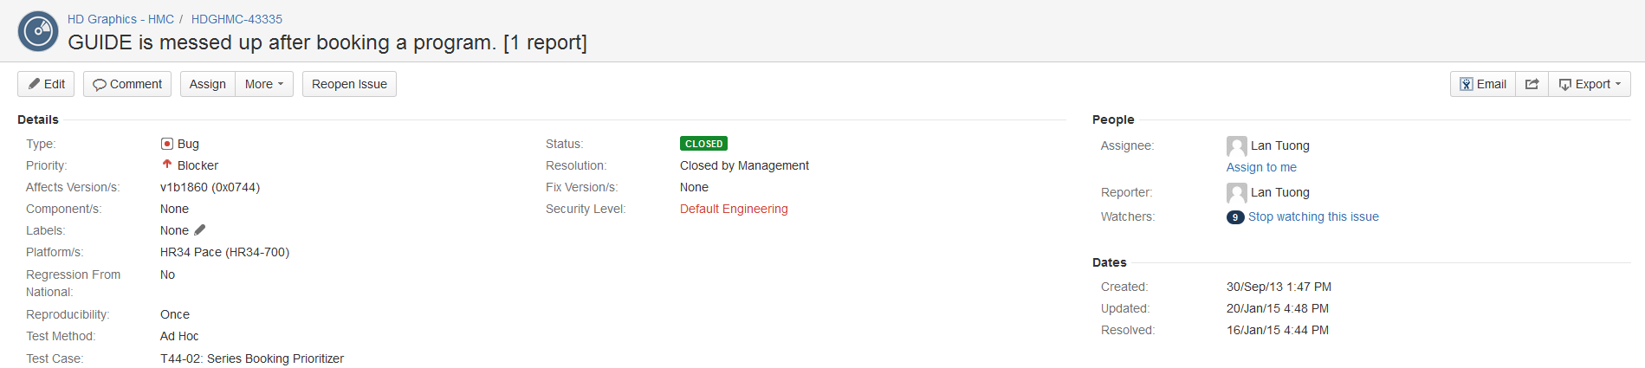
Search Issue - Quick Search
Quick Search supports going directly to an issue by typing the issue key or running a free-text search.
Jump to an Issue
The Quick Search box is located at the top right of your screen. If we type in a correct ID of an issue , you will jump straight to that issue
Ex: Type in “HDGHMC-43335” and press Enter, you will be redirected to the JIRA issue with ID = “HDGHMC-43335“

Slide 9

Search Issue - Quick Search (cont.)
Free text searching:
We can search for any word within the issue(s) we are looking for, provided the word is in one of the following fields.
  Summary.
  Description.
  Comments.

Slide 10
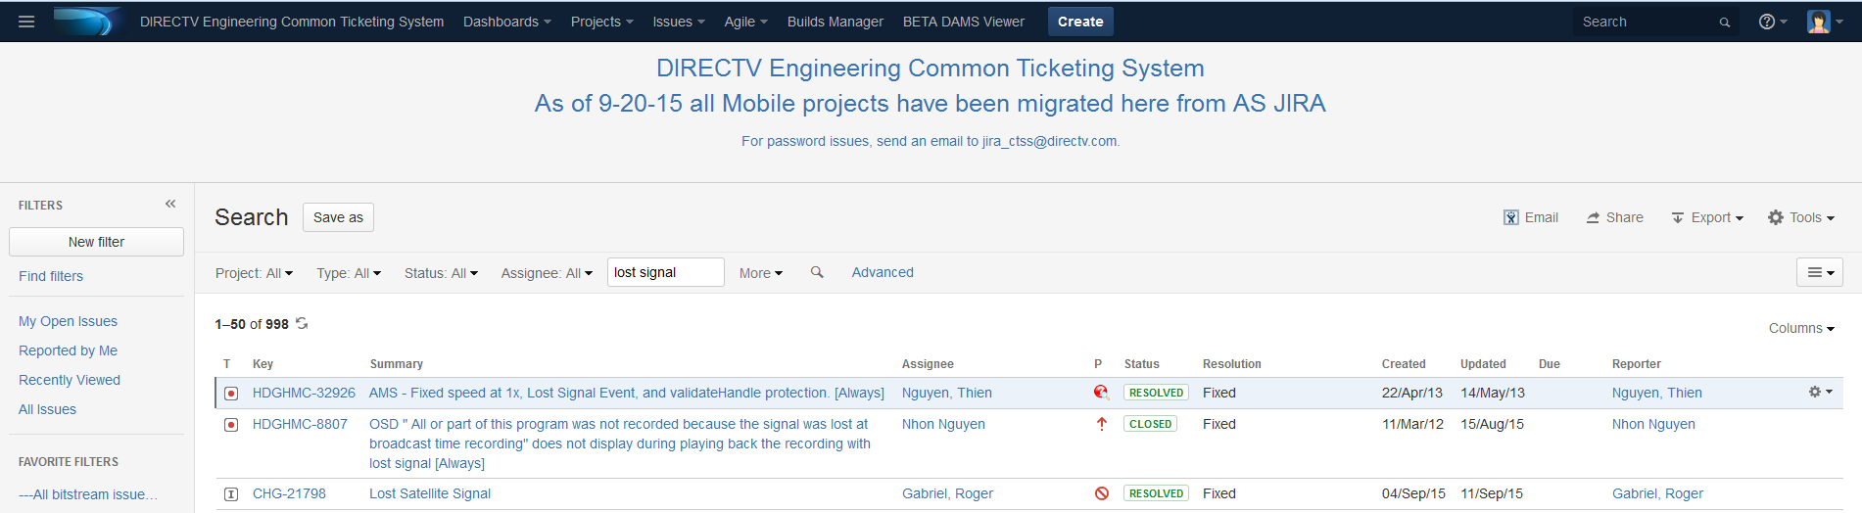
Search Issue - Quick Search (cont.)
Free text searching (cont.)
Example: type the string “lost signal” and press Enter, all the issues which contain “lost”, “signal”, or “lost signal” are listed as the search results

Slide 11
Search Issue - Quick Search (cont.)
Quick Search also let users perform “smart” searches with minimal typing. The following table lists some search terms that Quick Search support:
Search Terms | Description | Sample
My | Find issues assigned to me. | my
r: | Find issues reported by you, another user. Using the prefix r: followed by a specific reporter term such as me, username. | r:me – your issues r:lantt – “lantt” issues
<priority> | Find issues with a particular Priority. | Blocker, Major, Critical
<issue type> | Find issues with a particular Issue Type. Note that you can also use plurals | Bug, Task, New Feature
Type “r:me” text and press Enter, all the issues created by “me” (current user) will be listed in search results.

Slide 12
Search and Filter Issues
Quick Search
Basic Search
Advanced Search
Issue Filters

Slide 13
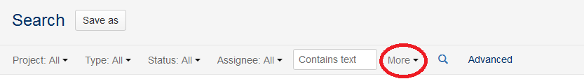
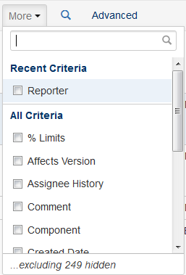
Search Issue - Basic Search
How to perform a search:
On the top navigation bar, click the 'Issues' tab -> select “Search for issues”
Searching on specified fields:
  Select fields as criteria. New instant search bar is visible and 4 search fields are defaulted including The Project, Issue Type, Status and Assignee fields.
  User can set visible and hide any search fields criterion in the More option
Notes:
Searching against specified fields — you need to select the fields then specify the fields values that you want to find

Slide 14
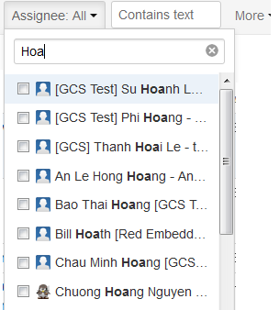
Search Issue - Basic Search (cont.)
How to perform a search:
Searching on specified fields (cont.):
  Specify the value for each field — Click the field criterion and tick/enter the desired value in the dropdown. If the desired value is not shown in the list, start typing the name of the value to filter the list
  Click on the Search button to perform the search

Slide 15
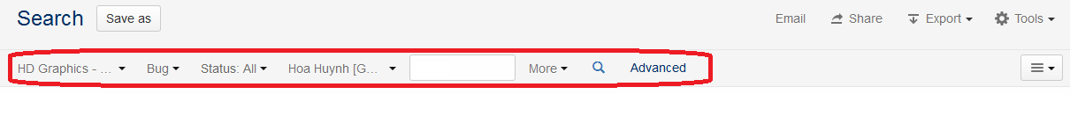
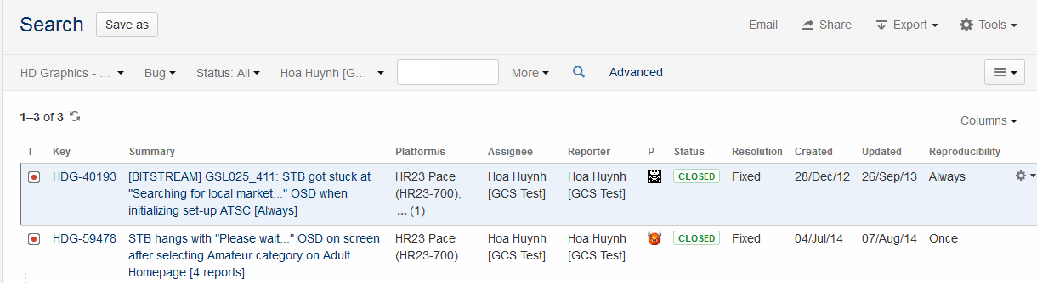
Search Issue - Basic Search (cont.)
How to perform a search:
Searching against specified fields (cont.):
  Example: To search for all bugs opened in the “HD Graphics – Hx2x (HDG)” project, with “All” status, by user “hoahtk”, the filter should be:
  Press Enter, the result will show below

Slide 16
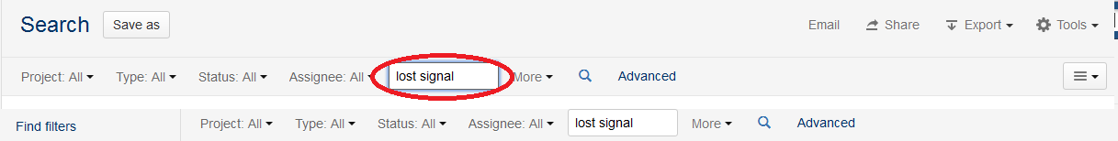
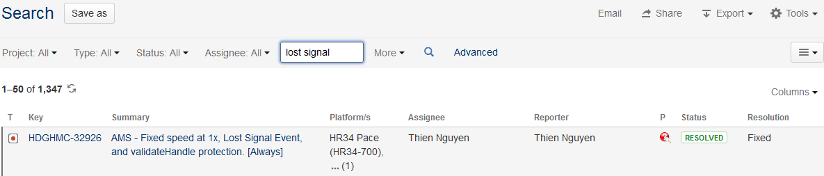
Search Issue - Basic Search (cont.)
How to perform a search (cont.):
Searching against specified text:
  Enter the desired text in the “Contains text” text box
  Press Enter => The Summary, Description, Comments, Environment fields and all text-based custom fields will be searched.

Slide 17
Search and Filter Issues
Quick Search
Basic Search
Advanced Search
Issue Filters

Slide 18
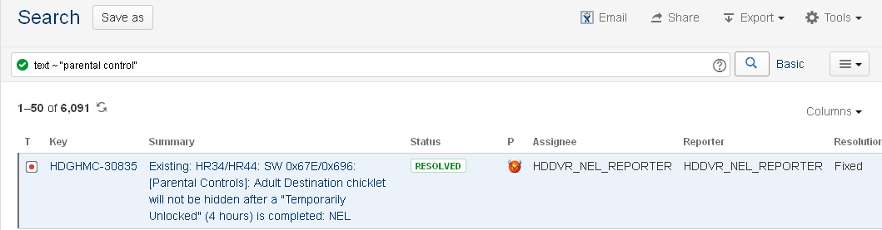
Search Issue - Advance Search
An advanced search allows you to use complex JQL queries to search for issues.
How to perform a search:
On the top navigation bar, click the 'Issues' tab => select “Search for issues” => the new instant search bar appears.
Click on “Advanced” link to switch from basic to advanced search.
Type JQL queries into the search box.
Click on the 'Search for issues‘ icon to perform the search.

Slide 19
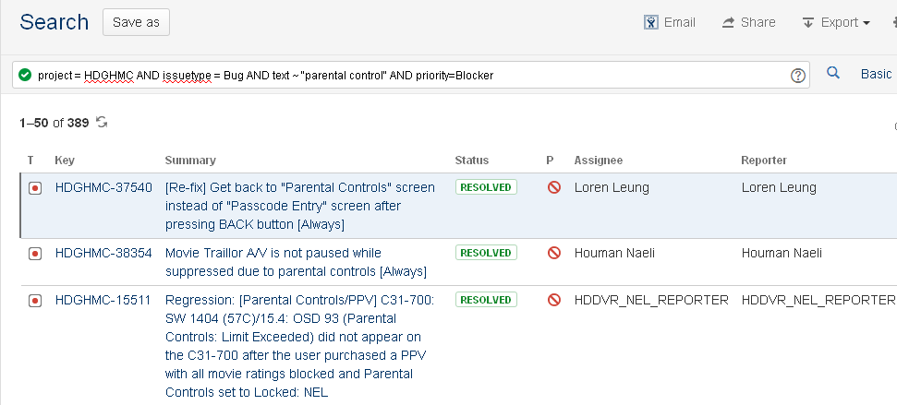
Search Issue - Advance Search (cont.)
For Example:
To search “parental control” issue which belongs to the “HD Graphics – HMC” project and has “Blocker” priority, type the following JQL queries into the search box:
  project = HDGHMC AND issuetype = Bug AND text ~ "parental control" AND priority=Blocker
Here is the reseult:

Slide 20
Search Issue - Advance Search (cont.)
Supported keywords, operators, fields, functions (refer to JIRA online help for a complete list)
  Keywords: OR, AND, NOT, EMPTY, NULL, ORDER BY
  Operators: =, !=, >, <, >=, <=, IN, NOT IN, ~ (contain), !~,…
  Fields: assignee, created, category, project, priority, reporter, status, text, type, updated, description, watcher, resolution,…
  Functions: membersOf(), currentUser(), currentLogin(), lastLogin(), startOfDay(), endOfDay(), startOfWeek(), endOfWeek(), startOfMonth(), endOfMonth(), releasedVersions(), unreleasedVersions(), latestReleasedVersion(), earliestUnreleasedVersion()…
JIRA supports the Auto-complete function: As you type your query, JIRA will recognize the context and offer a list of "auto-complete" suggestions for you.
We can save the query for future use. We can also share the query with a Group, Project or Everyone to utilize it.

Slide 21
Search Issue - Advance Search (cont.)
JIRA also supports users searching for issues based on their history using CHANGED and WAS operators.
For example:
To find any issues whose Status field value was at some point "In QA Review" but changed to "QA Rejected", by user freddo between the start and end of the current week.
  status changed FROM "In QA Review" TO "QA Rejected" BY freddo AFTER startOfWeek() BEFORE endOfWeek()
To find any issues whose Fix Version field was at some point (or currently is) set to 4.4.
  fixVersion WAS 4.4

Slide 22
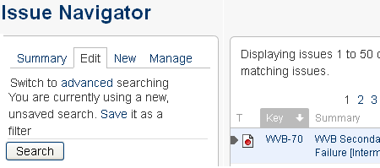
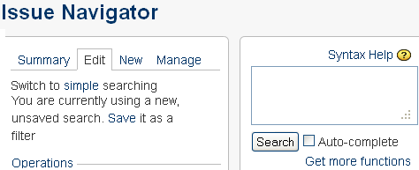
4.3. Search Issue - Advance Search (cont)
Switching between Advanced and Simple Search
On the top navigation bar, click the "Issues" tab. This will display the Search panel, this is also he Simple Search page. On this, click "advanced". This will display the "Query" box of the Advanced Search.
The same, on Advanced Search page, click on “simple” to switch back to the Simple Search.
In general, a query created using 'Simple Search' will be able to be translated to 'Advanced Search‘, and back again. However, a query created using 'Advanced Search' may not be able to be translated to 'Simple Search‘, particularly if the query contains one of the operators below: OR, NOT, EMPTY, !=, IS, IS NOT, >, >=, <, <=, or the query specifies a field and value that is related to a project.

Slide 23
Search and Filter Issues
Quick Search
Basic Search
Advanced Search
Issue Filters

Slide 24
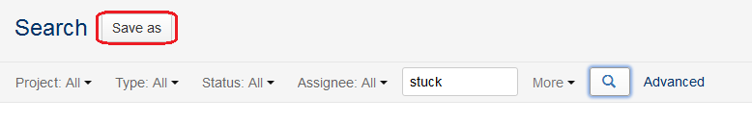
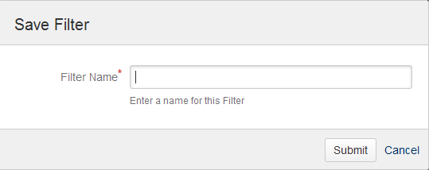
Issue Filters - Saving Searches
A saved search is called an 'issue filter'.
After doing your search, click the ‘Save as’ button.
Enter a name for the new filter and click Submit => Your filter is created and added to your favorite filters

Slide 25
Issue Filters – Manage Filter
On the navigation bar, click the 'Issues' dropdown and select 'Manage Filters' from the list.
The 'Manage Filters' page will display. From this page, you can perform the common functions listed below:
  Searching for a filter
  Updating a filter
  Deleting a filter
  Cloning a filter
  Adding a filter as a favorite.
  Sharing a filter that you have created with other users.

Slide 26
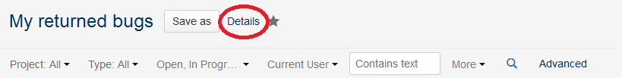
Issue Filters – Sharing a filter
Filters that you have created can be shared with other users via user groups, projects and project roles. They can also be shared globally.
To share an existing filter using the Details button
  Choose Issues > Manage Filters.
  Click the My tab. This tab displays all the filters that have been created by you.
  Locate the filter you wish to share and click on it.
  Click the Details link to the right of the filter's name, as shown here:

Slide 27
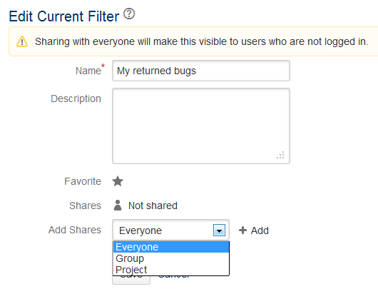
Issue Filters – Sharing a filter (cont.)
To share an existing filter using the Details button (cont.)
  Click Edit permissions to open the Edit Current Filter screen
  Update the Add Shares field by selecting the group, project or project role
  Click Save to save your changes

Slide 28
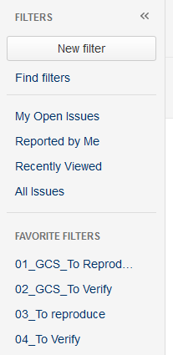
Issue Filters – Running a filter
On the navigator bar -> choose Issues > Search for Issues.
Choose any filter from the list on the left
  Find filters: lets you search for any filter that's been shared, which you can then subscribe to (adding it to your Favorite Filters).
  System filter — My Open Issues, Reported by Me, Recently Viewed, All Issues
  Favorite Filters

Slide 29
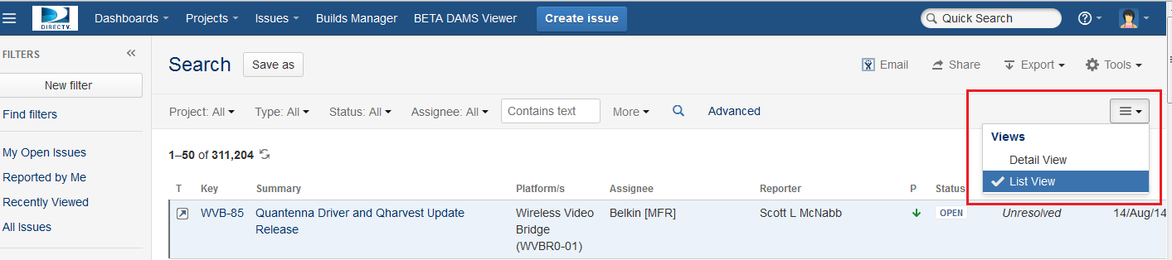
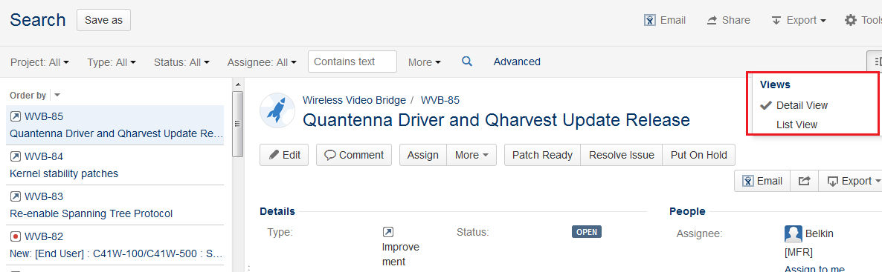
List View & Detail View
Pick the view that fits your work style.
  List View
  Detail View

Slide 30
Overview
  Access To JIRA
  Issues Navigator
  Common Action On An Issue
  JIRA Dashboard and share
  DAMS Viewer
  “Support” Project

Slide 31
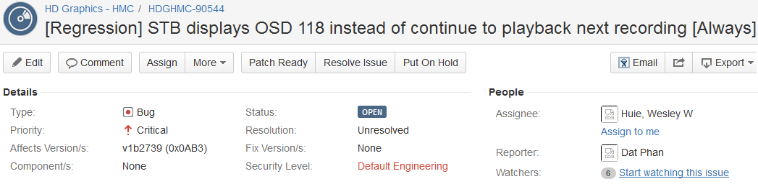
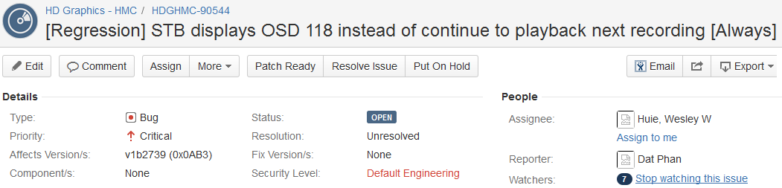
Watching Issues
Common Action on an Issue - Watching Issues manually
JIRA allows users to watch a particular issue, all watchers will be notified by email of any updates or comments on that issue.
Click on the “Start watching this issue” link to become a watcher of the issue.
Click on the “Stop watching this issue” link to stop watching the issue.

Slide 32
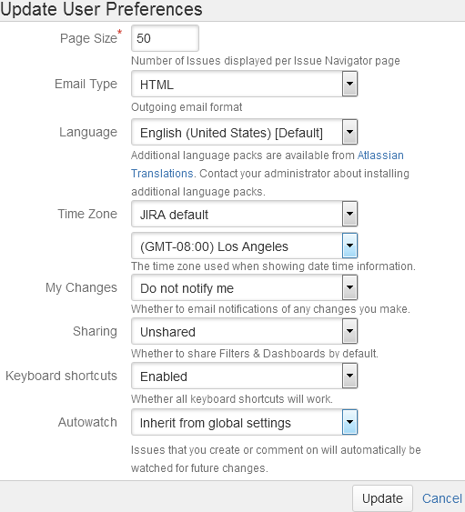
Common Action - Watching Issues - Autowatch
A JIRA user who either creates a new issue or comments on an existing issue, will automatically become a watcher of that issue.
If you don't want to automatically become a watcher of an issue you create or comment on, you can disable this feature through your user profile, by choosing Disabled for the Autowatch option when editing the Preferences section of your user profile

Slide 33
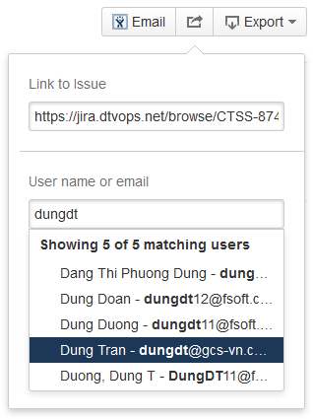
Common Action - Share Issues
The Share issues feature provides a way to share a Jira issue (or a list of Jira issues) with someone else. Recipients will be emailed a link to the issue(s).
  View any issue or a list of issues on the issue navigator, click the Share button at the top-right and specify JIRA users or any email address of people you want to share the issue with.
Notes:
Both Testers and Developers must familiar with this type of issue.
Testers are the one who usually creating this type of issue.

Slide 34
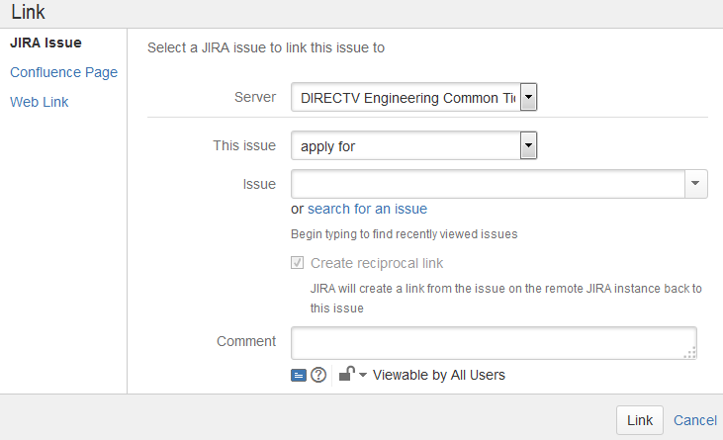
Common Action - Remote Issue Link
The remote issue link feature provides a powerful way to link JIRA issues to items external to your JIRA installation, residing on external applications.
  On an issue page, click on then select “Link”.
  Add an issue link from a JIRA issue to an issue on another JIRA site OR any webpage URL.
Notes:
Both Testers and Developers must familiar with this type of issue.
Testers are the one who usually creating this type of issue.

Slide 35
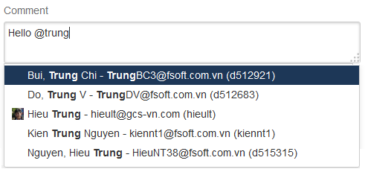
Common Action - Mention Users
When creating, editing or commenting on an issue, simply mention other JIRA users in an issue's Description or Comment field.
Any JIRA users mentioned on an issue will receive details about the issue in an email message.
  To mention a user, enter @ at beginning of a JIRA user.
Notes:
Both Testers and Developers must familiar with this type of issue.
Testers are the one who usually creating this type of issue.

Slide 36
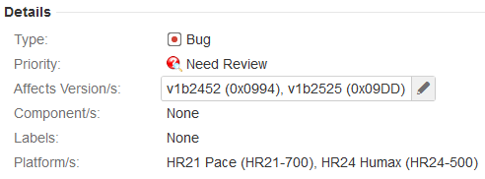
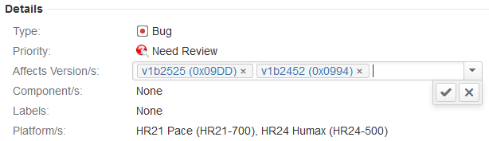
Common Action - Inline Editing
JIRA 6.2 makes working with issues faster with inline editing and fewer page reloads.
When viewing an issue, simply click on a field's content to begin editing it. Once you've finished editing, simply click on a blank area away from the field you're editing to save your changes – no page reload is required.
Notes:
Both Testers and Developers must familiar with this type of issue.
Testers are the one who usually creating this type of issue.

Slide 37
Overview
  Access To JIRA
  Issues Navigator
  Common Action On An Issue
  JIRA Dashboard and share
  DAMS Viewer
  “Support” Project

Slide 38
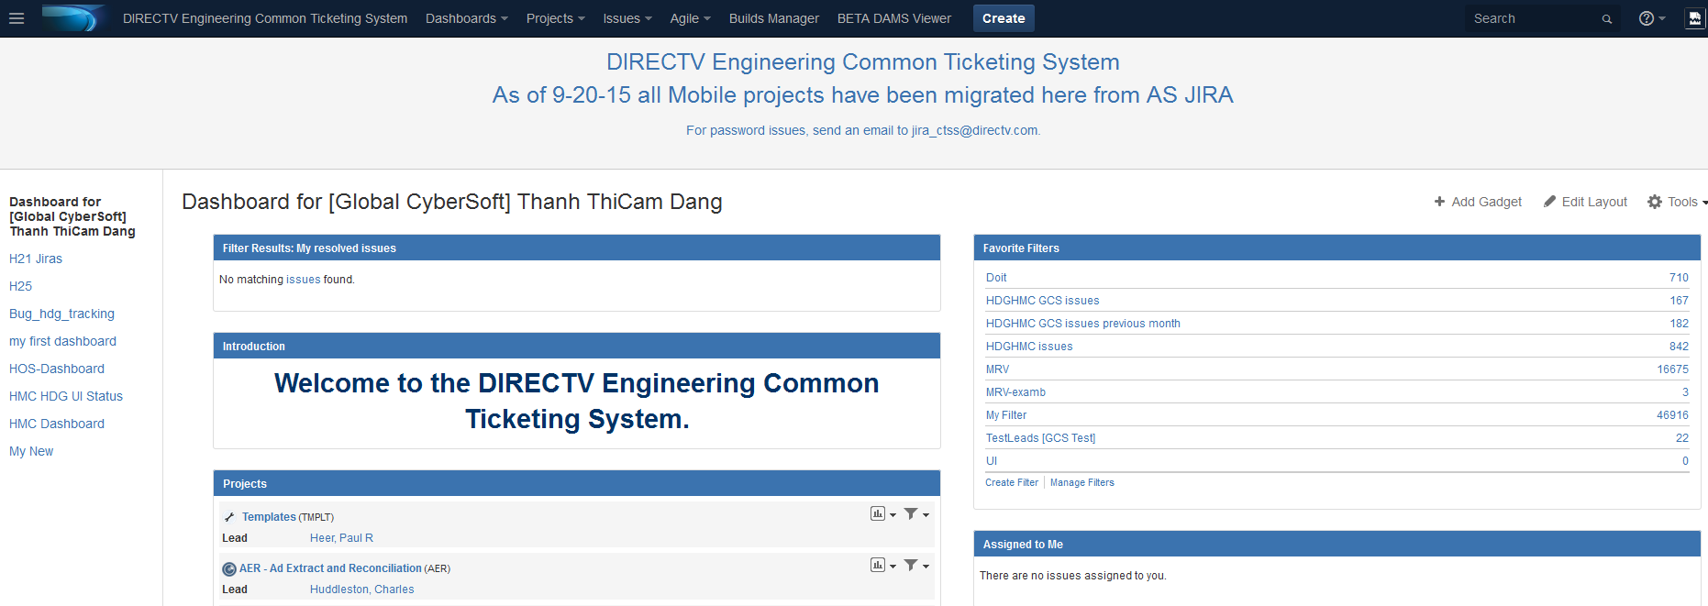
JIRA Dashboard - Overview
JIRA Dashboards is the first screen you see after you log into JIRA.
It can be configured to display many different types of information, depending on each user’s interest.
If you have not created any dashboards, you will see the system dashboard as below.
The information boxes on the dashboard are called Gadgets.
Notes:
The JIRA Dashboards is the first screen you see when you log in to JIRA.
It can be configured to display many different types of information, depending on your areas of interest.
The information boxes on the dashboard are called Gadgets

Slide 39
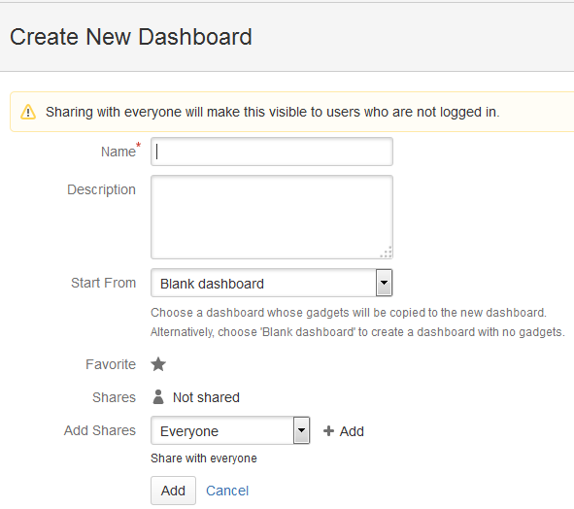
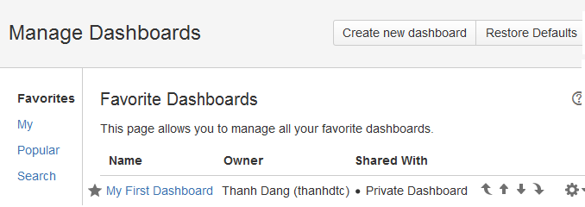
Dashboard – Create new dashboard
On the top navigation bar, click the ‘Dashboards' tab => select “Manage Dashboards”.
Select “Create new dashboard” button
Notes:
There is another way to create a new dashboard: on System Dashboad -> Select Tools on the up right side -> Create Dashboard
Both ways will lead you to the same “Create New Dashboad screen”.
On Create New Dashboard screen,

Slide 40
Dashboard – Customize Dashboard
You can easily customize your dashboard by
  Adding more gadgets
  Dragging and dropping to reposition the gadgets
  Changing the look of individual gadgets
  Choosing a different layout
You can also
  Create more pages for your dashboard
  Share your pages with other people
  Choose your favorite pages

Slide 41
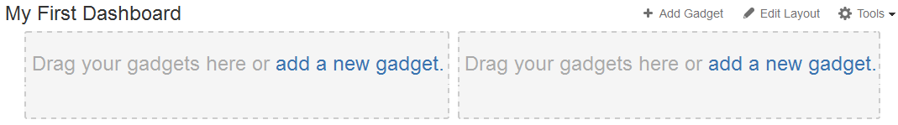
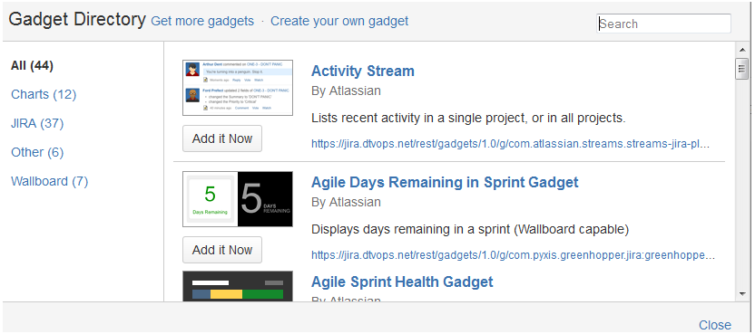
Dashboard – Customize Dashboard (cont.)
Add gadgets:
Notes:
Click on “add new gadget”
Then select the “Gadget
You can easily customize your dashboard by choosing a different layout, adding more gadgets, dragging the gadgets into different positions, and changing the look of individual gadgets.

Slide 42
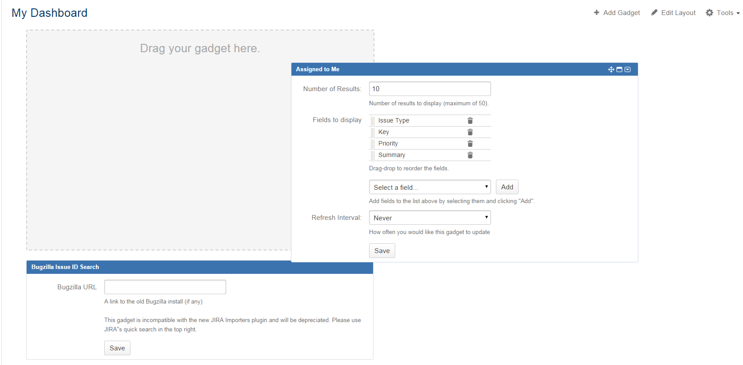
Dashboard – Customize Dashboard (cont.)
Drag and Drop
  Click on the header of each gadget
  Drag it to the desired location to reposition

Slide 43
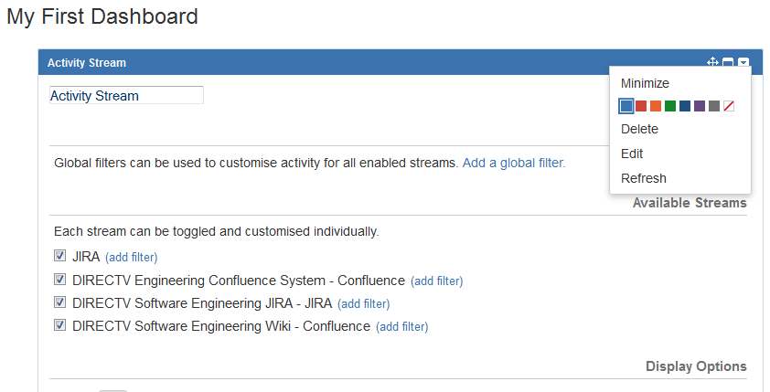
Dashboard – Customize Dashboard (cont.)
Change gadget style:
  You can change the individual look of a gadget by clicking the dropdown icon from the gadget header, then choose the desired color

Slide 44
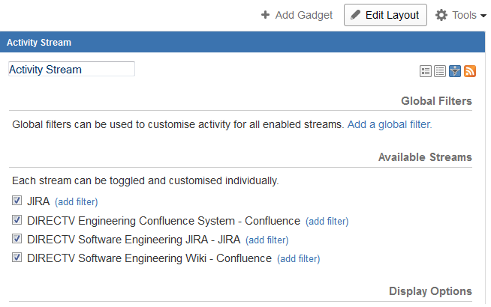
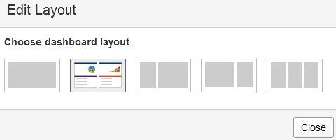
Dashboard – Customize Dashboard (cont.)
Layout
  You can easily customize your dashboard by choosing a different layout
  Click "Edit Layout", then choose the layout you want

Slide 45
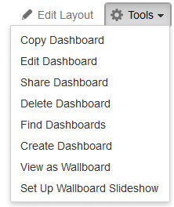
Dashboard – Customize Dashboard (cont.)
Copy Dashboard
Edit Dashboard
Share Dashboard
Delete Dashboard
Find Dashboard
Create Dashboard
View as Wallboard
Set Up Wallboard Slideshow

Slide 46
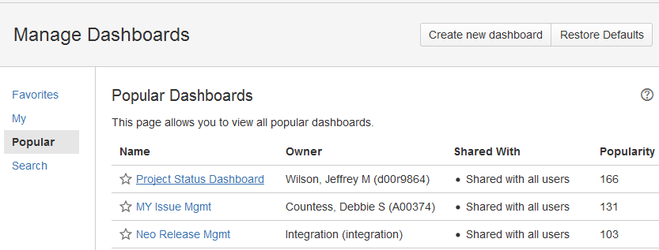
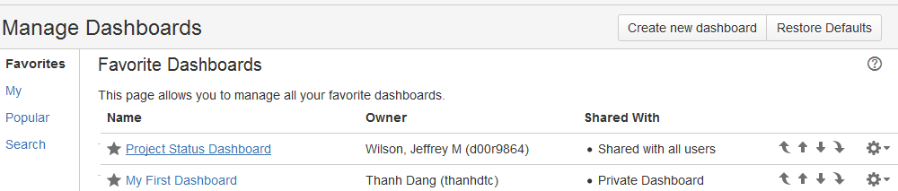
Dashboard – Customize Dashboard (cont.)
You can add a dashboard to your favorites by clicking on the start next to the name

Slide 47
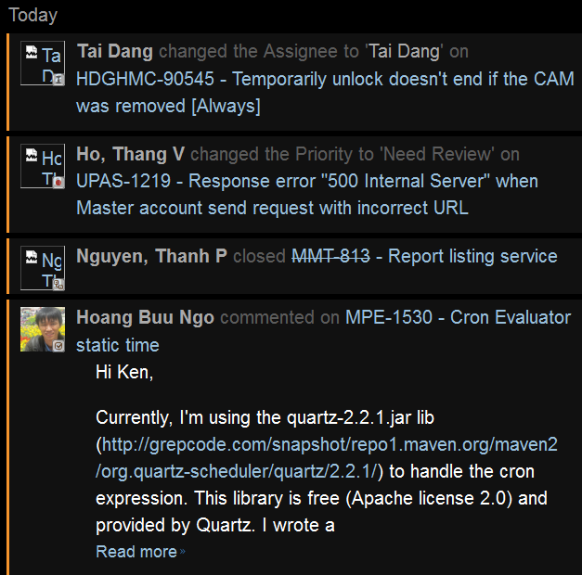
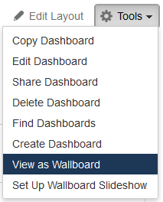
Dashboard – Customize Dashboard (cont.)
View as Wallboard:
  Select Tools -> View as Wallboard to view your current selected dashboard as a Wallboard.

Slide 48
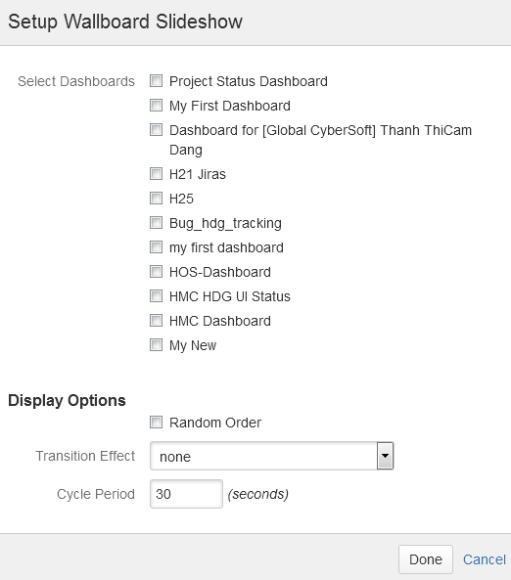
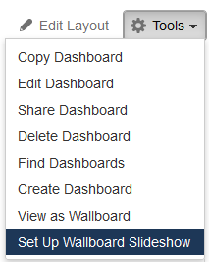
Dashboard – Customize Dashboard (cont.)
Set-up Wallboard Slideshow: You can edit how Wallboard shows by selecting Tools -> Set Up Wallboard Slideshow

Slide 49
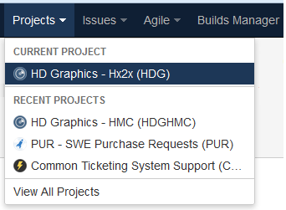
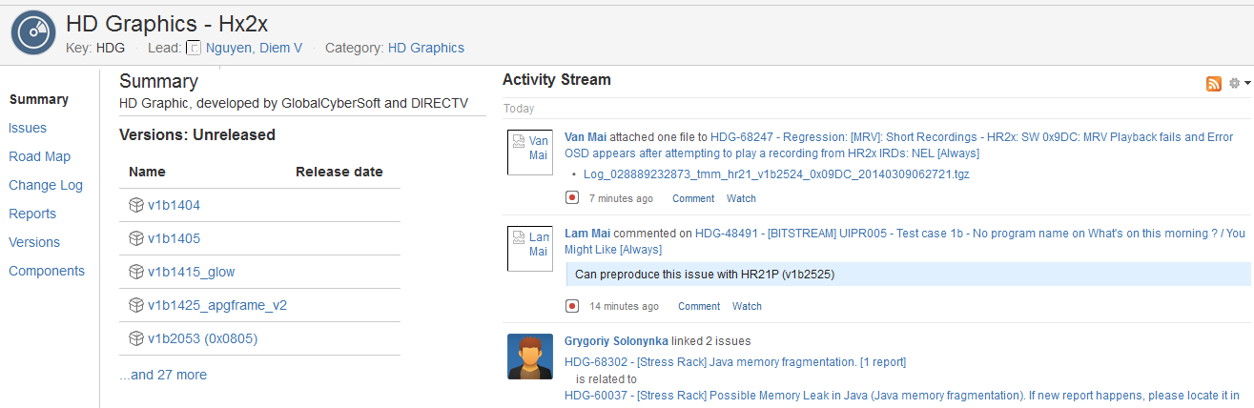
Browsing a Project
The project browser screen: provides a general overview of your project, with a variety of easily accessible reports for your project's issues, build and source code reviews, from which you can 'dig down' into further detail.

Slide 50
Browsing a Project – Project Information
Choosing a project, then you can browse the following:
  Summary: Shows recent activity in your project
  Issues: Shows a summary of all issues in a project grouped by Status
  Road Map: Shows unresolved issues for upcoming versions of a project.
  Change Log: Shows resolved issues for previous versions of a project.
  Report: Shows a list of templates for the user to easily create a report of a project.
  Versions: Shows a summary of recent versions for a given project.
  Components: Shows a summary of all components for a given project.

Slide 51
Overview
  Access To JIRA
  Issues Navigator
  Common Action On An Issue
  JIRA Dashboard and share
  DAMS Viewer
  “Support” Project

Slide 52
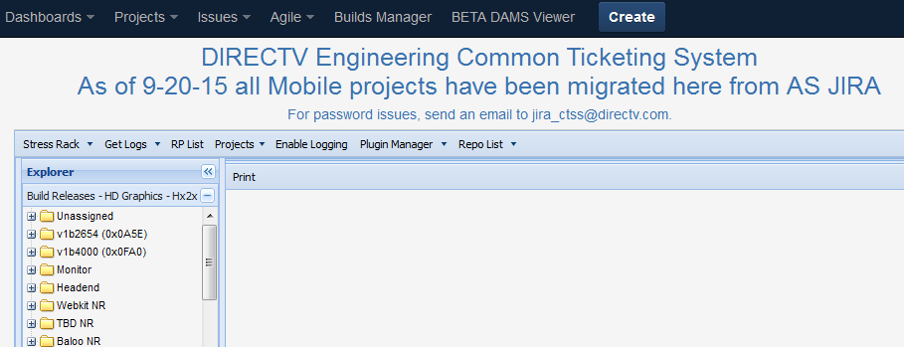
DAMS Viewer
DAMS Viewer provides users with some useful facilities to learn about projects such as their releases and fixes, comparing the fixes between releases, attaching logs to an issue, RP List, Plug-in Manager, …
To open the DAMS Viewer: On the top navigation bar, click the ‘BETA DAMS Viewer' tab => the DAMS Viewer is opened with the current project’s releases listed on the left panel.

Slide 53
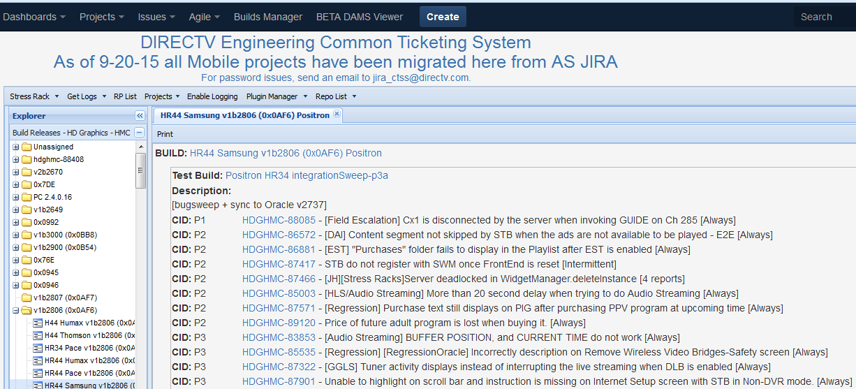
DAMS Viewer - Detail Of A Release
To change a project: click on the “Projects” drop down list arrow, then select your desired project => The releases list is updated according to the new project.
To view detail information of a release, double click on the release => the fixes in the detail of the release are displayed on the right panel.

Slide 54


DAMS Viewer - View Tags Of A Release
To manage tags of a Build Release ticket, right click on a platform of a build, select Tag info, select Build Tags tab, and click on “Get Tag List” => A list of all tags belonging to the Build is displayed.
If the tags of the release have been updated, select “Force Recomputed of Tag List”.

Slide 55


DAMS Viewer - Fixes Between Two Releases
To compare the fixes between two releases: select 2 releases then right-click on one of them and then select “Accumulate Info” => the comparison results are displayed on the right hand side of the screen.

Slide 56

DAMS Viewer - RP List
JIRA provides a list of shared filters or queries for users to utilize them.
  On the navigation bar, click the “RP List” => This will display the RP List screen with lots of shared filters/ queries.
  Select a filter you want to execute then click on the “Go“ button => This will display the filter results with the issues’ keys and descriptions.

Slide 57

DAMS Viewer - Get Logs
We can attach logs from the STB to an issue by using the “Get Logs” facility.
To attach logs: click on “Get Logs”, then enter the “Log Key” that was created when getting logs from the STB, and enter the “Issue To Attach” (the issue ID), then click on “OK” button => the logs will be attached to the issue in a while.

Slide 58
Overview
  Access To JIRA
  Issues Navigator
  Common Action On An Issue
  JIRA Dashboard and share
  DAMS Viewer
  “Support” Project

Slide 59

Support project
When managers or supervisors request the Support team to help them with creating or updating an Open Air Account, providing a Virtual Machine, doing a Task, buying new devices, creating new Project, they have to submit tickets on the "Support" project.

Slide 60

Support project (cont.)
For example, I need equipment for testing in my team. I will create a request for fixing it.
The ticket should be:
  Project: PUR –SWE Purchase Requests.
  Issue Type: SWE Purchase Request.
  Summary: Equipment Request for test team – TP-Link.
  Impacted Organization : Mobile
  Cost Estimate : 130
  Project Charge Code : X05ABC123.
  Description: A TP-Link is needed for test team to execute wireless test cases…
  Business Justification: 24h.
Then click on "Create" button.

Slide 61
Thank you

